Slide 1

EVASION TECHNIQUES EMPLOYED IN MALWARE: THE RAMSOMWARE CASE STUDY
DANYAL NAMAKSHENAS
AND
FAITH C. OBASI

Slide 2
To do List
Introduction
Case Study
Analysis
Findings
Detection
Conclusion

Slide 3

Introduction
What is a Ransomware?
What are the general characteristics of a Ransomware?

Slide 4
Case Study
Blackbyte ransomware variants
Clop ransomware variants

Slide 5
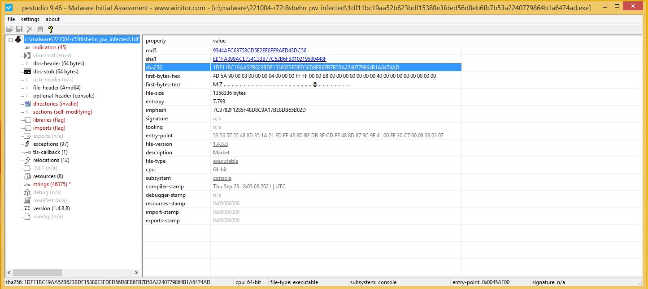
Static Analysis
(Initial Stage)
Extracting the static features of the malware using PeStudio
Finding the MD5 Hash of the file for further analysis
Notes:
When it comes to analyzing an executable, the first thing is to extract its static features.
One tool that allows us to do so is ‘pestudio’. After opening the file in pestudio, we can compare its checksum in any publicly available virus databases such as ‘virustotal’.
Since the executable was packed, we could guess that there shouldn’t be any valuable human-readable strings in the executable. However I took a quick look at the extracted strings and found something interesting.
You can see that the company’s name is Amazon corporation. This also can be seen in the executable properties. Interesting, isn’t it?

Slide 6
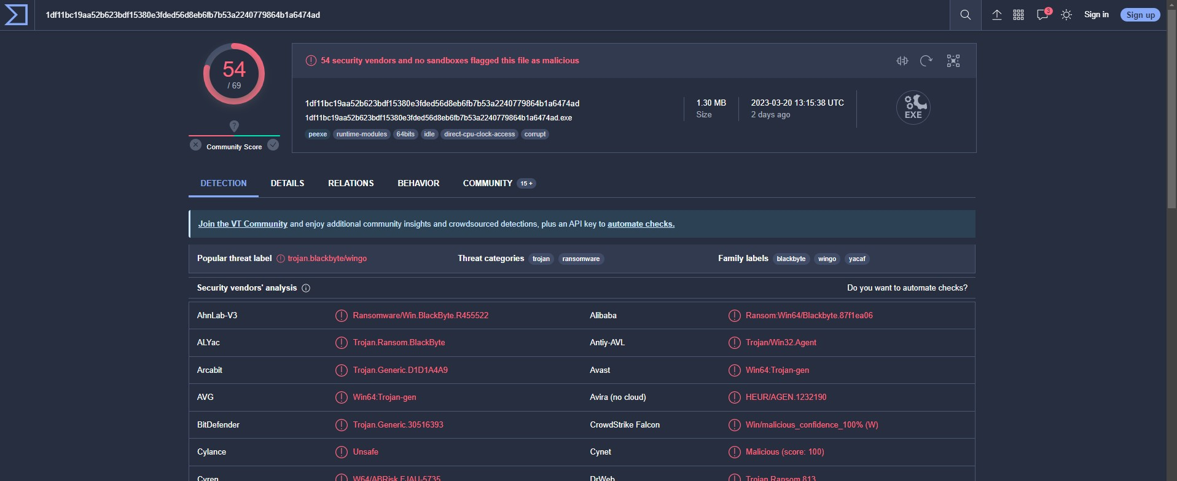
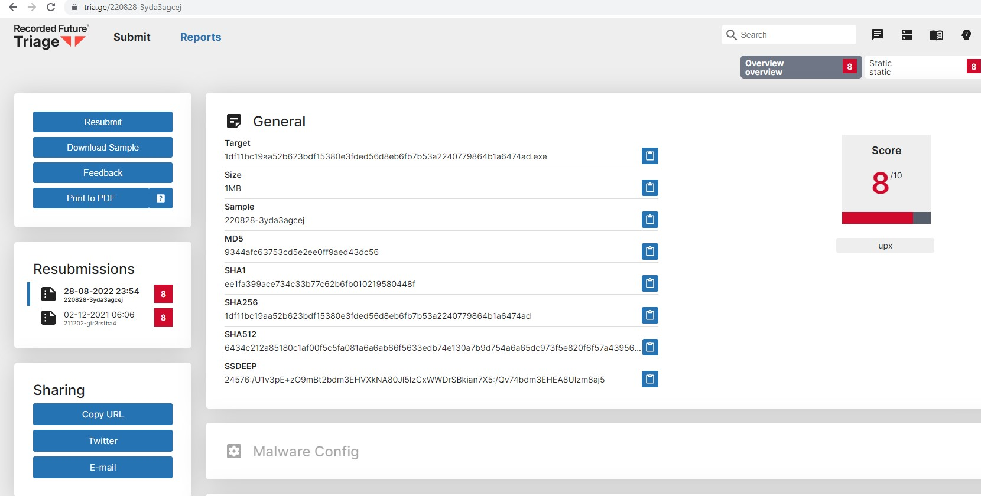
Online Engine Scans (VirusTotal and Tria.ge)
Further Analysis using Virus Databases and a Sandbox
Notes:
You can see both virus databases indicate the executable as ransomware.
However there are some variant of the ransomware that won’t turn on any red flag on these databases since even a small change in the code can change the checksum value completely.

Slide 7

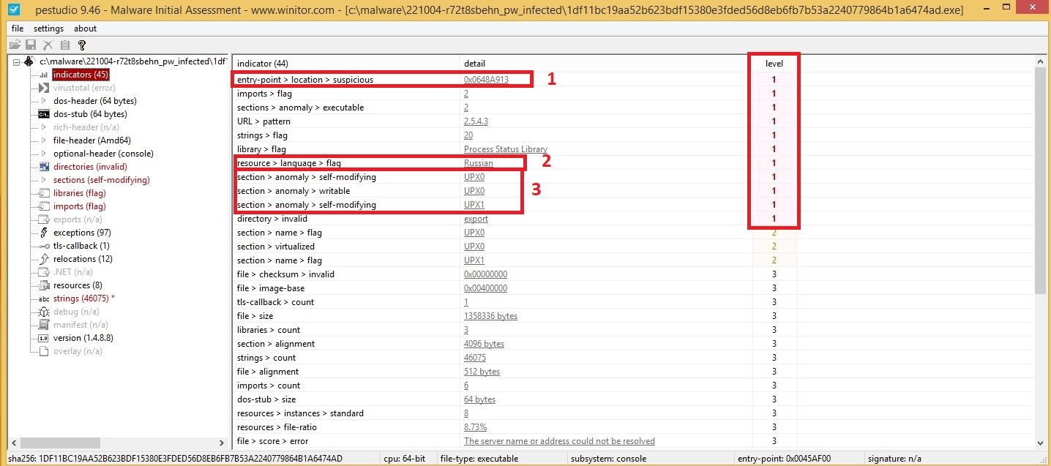
Suspicious Indicators
Entry point into the program
Resources flag
Obfuscation (packing using UPX 0 and UPX 1)
Notes:
Looking at pestudio indicators, we can see many red flags in here. The first one indicates that the entry point to the program is suspicious. Meaning that a normal executable won’t start from that point usually.
Also, we can see that in resources part there is a red flag indicating Russian. After some researches, I realized that this means, if the ransomware is running on a Russian machine, it terminates itself.
Last but not least, it is shown that the executable is packed by UPX 0 and UPX 1.

Slide 8
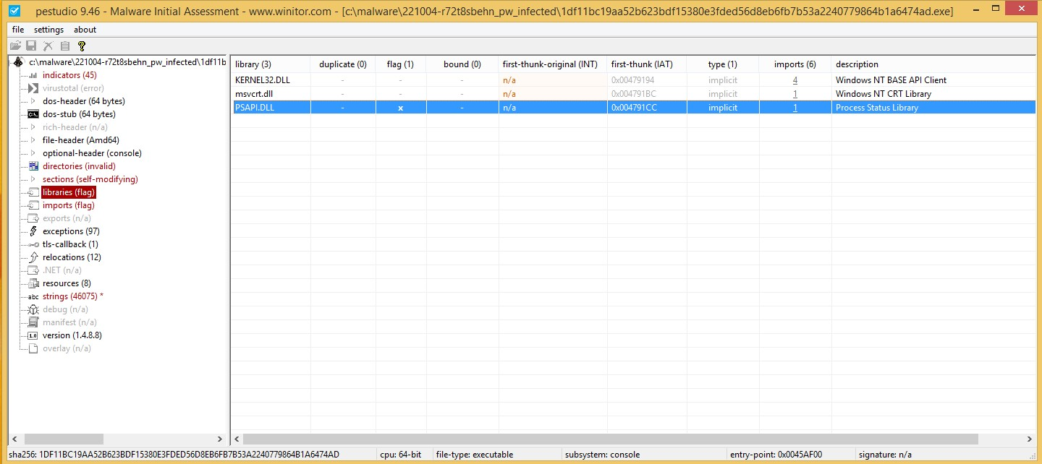
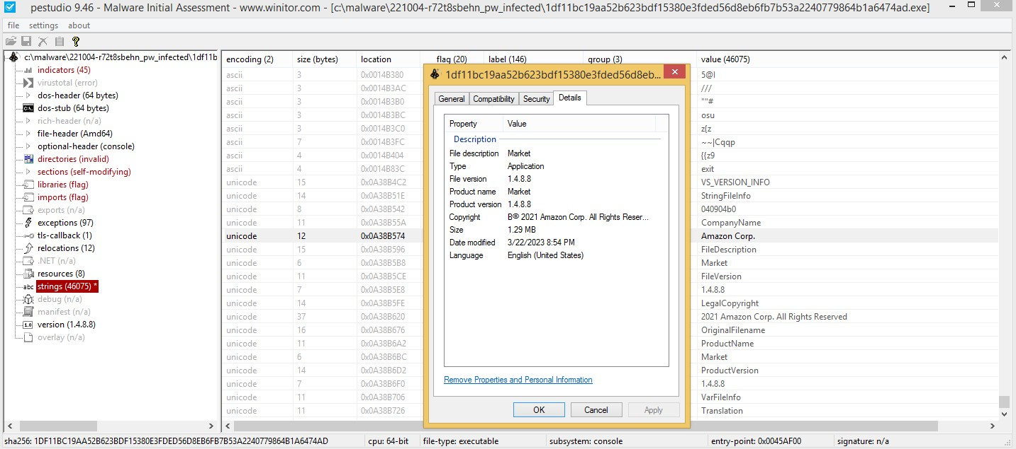
Static Analysis (Libraries)
PSAPI.dll is a dynamic link library file in the Windows O.S that provides functions for working with APIs.
It is used for:
1. Retrieving process information
2. Enumerating modules and processes
3. Monitoring system performance
Notes:
When we see a packed or obfuscated executable, it is likely that we won’t be able to see the libraries used by the executable.
But here we can see three libraries are shown or forgotten by the program developer to be packed. The first two are common to be used by any program.
But the third one…

Slide 9
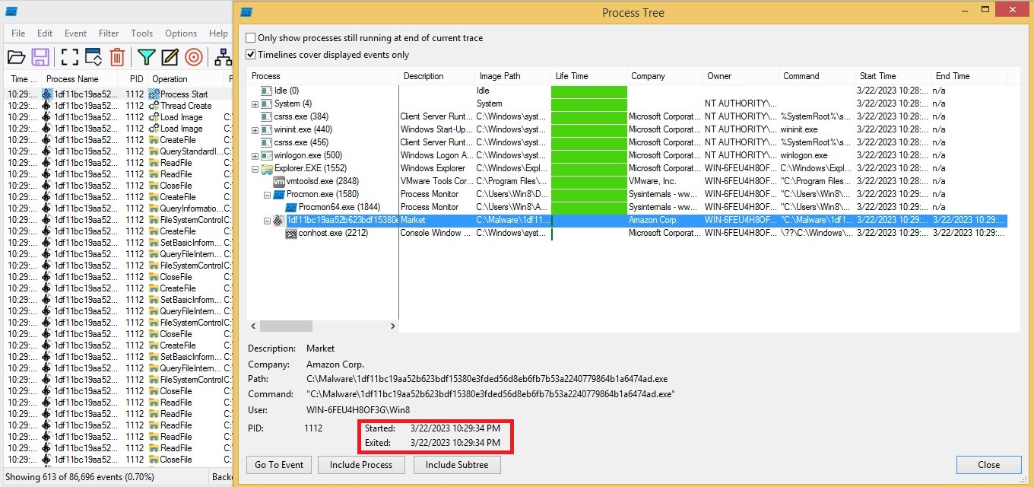
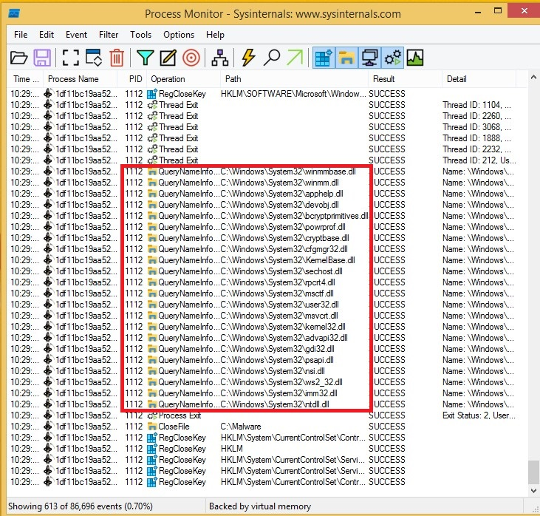
Behavioral Analysis
Something Interesting?
Notes:
This time, I ran a clean snap shot of the windows, and opened process monitoring app on the background to capture every single activity on behalf of this executable.
We could find something strange. The process was actually ran on the background for a few milliseconds but terminated. Also, I could extract the hidden libraries used by the executable.

Slide 10
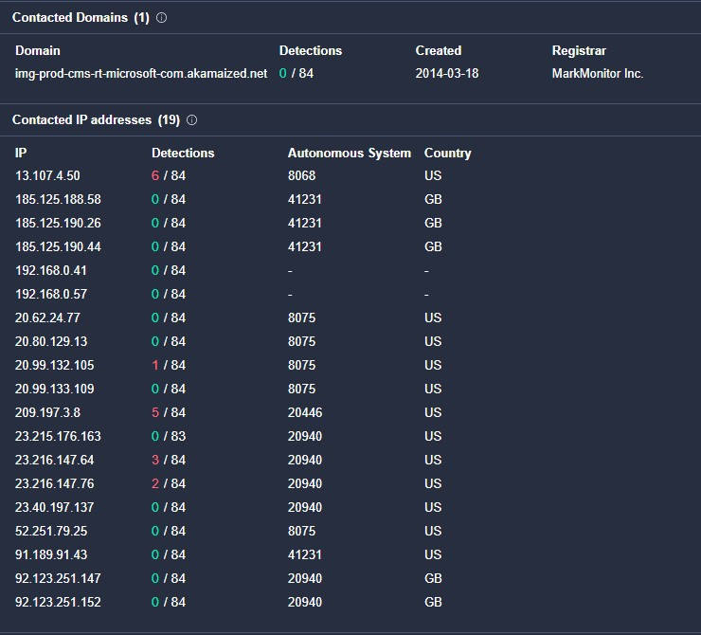
Findings
(Domains)
Notes:
We were done with the static analyses and so far we could identify suspicious indicators. But to what extent they are reliable?
Until we can’t recognize any malicious activity, can we say that it’s a ransomware or any other kind of malware?
So we decide to run it under an isolated environment, guess what? I couldn’t see any suspicious activity on my windows. I try to restart my windows and it boot up as it should and worked normally.
I also looked at a couple of registries that usually used for persistence techniques. No indicator, No changes.

Slide 11
Findings
(File Hashes)
The hashes of some files that may have been affected by the blackbyte ransomware.
Notes:
Since we weren’t able to do a more complex behavioral analysis due to the evasion techniques used by the ransomware, we’ve done some investigations to find IoCs that an infected system may have, and could find a list of files that is possible to be left on the victim’s hard drive.

Slide 12
Detection
rule detect_blackbyte { meta: author = "Faith and Danyal" description = "Detects Blackbyte ransomware" strings: $string1 = “Local\TM.750ce7b0-e5fd-454f-9fad-2f66513dfa1b” $string2 = "CicLoadWinStaWinSta0" $string3 = "Local\SM0:2524:120:WilError_01" condition: any of ($string*) and (entrypoint == 0x0648A913) }
Yara Rules

Slide 13

Conclusion
Summary of Evasion Techniques Found;
1. Polymorphism
Obfuscation
2. Anti-analysis
3. Registry modification
4. Language identification features
5. Disabling EDR, Anti-viruses and ETW

